Slide 1




HOUSING SOLUTIONS LAB
Exploring housing options
For older adults
<<name of presenters>>
<<group presenting for>>
<<date>>
Notes:
Note: this slide deck uses the font family Barlow, which may need to be downloaded in order to view these slides correctly.
Welcome participants to this session
Share a land acknowledgement
We are excited to share our work on the Housing Solutions Lab, which was completed by SFU Renewable Cities in partnership with the Hollyburn Community Services Society
If you have questions as we go along, feel free to add them to the Q&A function or write them in the chat – we'll have time for this at the end. (assuming it is online)

Slide 2



Acknowledgements
  This content was published by SFU Renewable Cities, as part of the Housing Solutions Lab, under Creative Commons CC BY-NC-SA 4.0 license.
  Funders
  The Seniors Hidden Housing Solutions to Affordability and Climate Change received funding from Canada Mortgage and Housing Corporation (CMHC) under the NHS Solutions Labs, however, the views expressed are the personal views of the author and CMHC accepts no responsibility for them.
  « Seniors Hidden Housing Solutions to Affordability and Climate Change » a reçu du financement de la Société canadienne d’hypothèques et de logement (SCHL) en vertu du les laboratoires des solutions de la SNL Cependant, les opinions exprimées sont les opinions personnelles de l'auteur et la SCHL n’accepte aucune responsabilité à l’égard de telles opinions. »
  Additional funding received from Vancity.
Notes:
This material was published by Simon Fraser University (SFU) Renewable Cities, a program of the SFU Morris J. Wosk Centre for Dialogue, 2024.
This report is offered under the Creative Commons Attribution-NonCommercial-ShareAlike 4.0 License, enabling free sharing and reprinting for non-profit and non-commercial purposes with attribution.
For more information about the Housing Solutions Lab, please visit the Renewable Cities website – renewablecities.ca – or seniorshousingnavigator.ca

Slide 3

In your lifetime, have you lived with people outside of your family or significant other(s)?
Notes:
POLL: In your lifetime, have you lived with people outside of your family or significant other(s)?
A significant other could be a partner or a spouse. We’re asking this question at a high level – no specific timeframe requirements, and it is your own definition of living with someone – could be roommates, home sharing or other situations.
(can use prompt if waiting for responses still)
In two or three words, what was that like for you? We invite you to share in the chat. What words come to mind when you think of that experience?
Presenter to report back what is shared in the chat or summarize what is shared in the room
Some of us have experience with sharing space in our homes with others outside of our family or partners, and some of us may not
Sharing homes is a very personal act with lots of complexities. This is something we noticed during the Housing Solutions Lab

Slide 4


Agenda
  Our context + focus
  Costs and benefits of these solutions
  What was shared from engagement sessions
  Pilot program design
  Considerations for service providers
  Possible extensions
Notes:
Our plan for this session
Our context + focus
Costs and benefits of each type of housing solution
What was shared during engagement sessions
Pilot program design
Considerations for service providers
Possible extensions + looking ahead

Slide 5
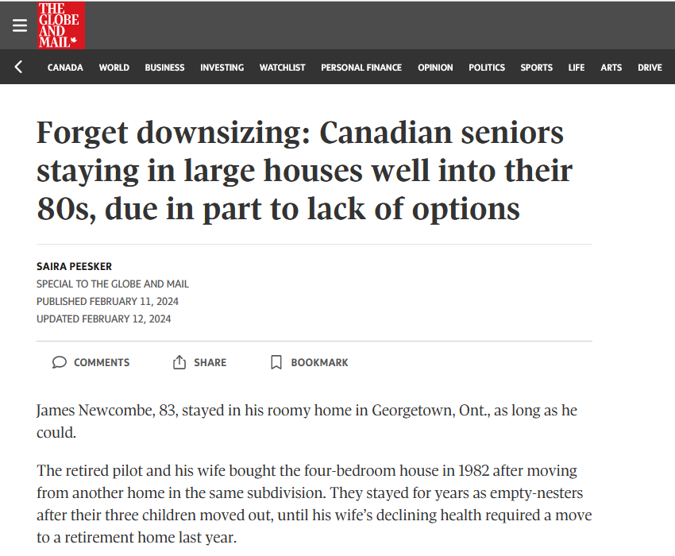
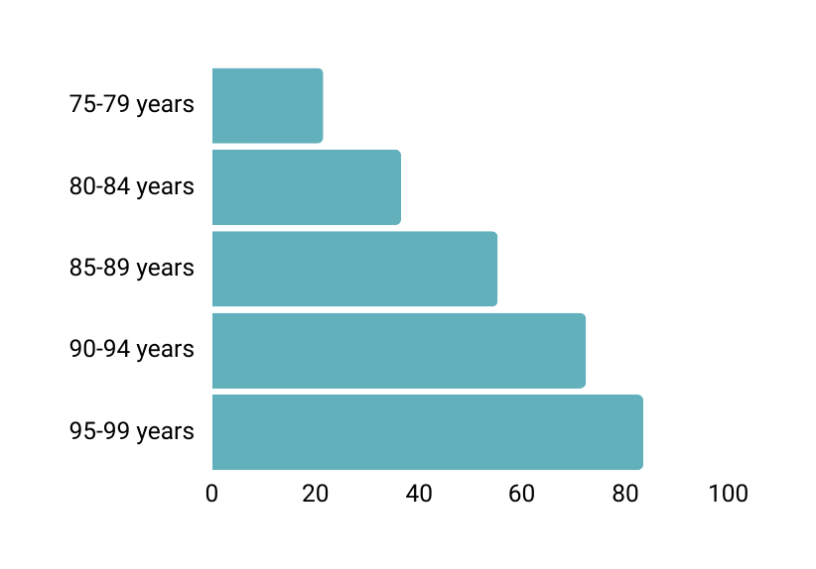
Context: Aging in single-detached homes
  53% of Canada’s housing stock is single-detached homes
  People are staying in their houses for longer as they age due to:
    Lack of downsizing options
    High costs of moving
    Healthier aging population with desire to stay in community
Sell rate (%) among elderly Canadian households by age groups between 2016 and 2021
CMHC, Housing Market Insight, November 2023
Notes:
Context: why these housing solutions and the Housing Solutions Lab?
Housing stock: 53% of Canadian housing is single detached homes
Majority of these (55%) are occupied by one- and two-person households, who are often older adults
Aging population living in single detached houses is one of the reasons we chose our focus for the HSL
People are staying in their houses for longer (average age of selling their homes increased to age 85+, CMHC report Nov 2023)
Some reasons include:
High costs of moving and lack of downsizing options (not much diversity in housing supply)
Healthier aging population with a desire to stay in neighbourhood or community and live independently
Others? (feel free to add other reasons you know about in the chat)
Results in people not fully using their own homes (i.e., only using a portion of it) – some bedrooms are not used (e.g. rooms requiring access by stairs)
Through funding from CMHC and Vancity, we focused on housing solutions for older adults who are living in single detached homes either by themself or with one other person
Our goal: explore housing options and design a pilot program that matches older adult homeowners with potential renters
Not the silver bullet for the housing crisis (there are deeper root causes) – but one piece of the puzzle that could offer solutions for some communities

Slide 6



Housing solutions we explored
Home sharing
Secondary suites
Coach houses
  Private room
  Shared kitchen
  (Potentially) shared bathroom
  Separate unit
  Often basement or garden suites attached to the house
  Separate unit from house
These are also called accessory dwelling units (ADUs)
Notes:
What were some of the specific solutions we have been exploring?
The housing solutions we’re looking at are:
Home sharing
Home seeker has a private room, shares kitchen and potentially bathroom with home provider
Secondary suites
Separate unit (basement or garden suites attached to the house)
Coach houses (laneway houses)
Separate unit from the house
Coach houses and secondary suites can also be called accessory dwelling units (ADUs)

Slide 7
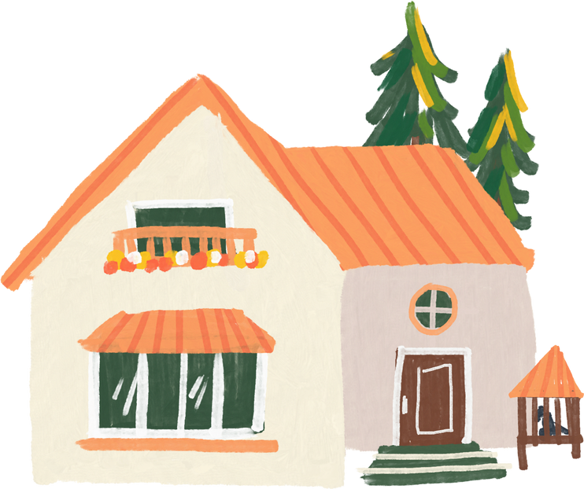
Accessory dwelling units (ADUs) in B.C.
More common in communities where:
  Residents pay a higher portion of income towards housing
  Single-detached homes have a high value
  There is tourism or valued amenities like waterfronts (e.g., in Tofino, Sun Peaks)
Also common in major urban centres, and mid-size communities
(e.g., Nelson, Esquimalt, Squamish, White Rock)
Notes:
Context of ADUs in B.C. (because two of three solutions are considered ADUs)
As we’ll mention in this session, we are in a changing provincial context in terms of housing legislation.
Generally, each local government has regulated ADU policies (until new provincial legislation comes in*)
Proposed provincial legislation will permit one secondary suite or one laneway home in all communities in B.C. (Bill 44, currently in third reading)
ADUs are often found in large cities in B.C., as well as smaller communities where:
Residents are paying a high portion of their income towards housing
Single detached homes have a high value
There is tourism or amenities/attractions (e.g., Tofino, Sun Peaks)
Mid-size communities like Nelson, Esquimalt, Squamish or White Rock

Slide 8




These solutions can help address many crises
Climate emergency
Social isolation
Affordability
Community connectedness
Notes:
The solutions explored by this lab seek to help address many interconnected crises.
We sought to approach the lab using a multisolving lens and we explored how these housing solutions might address.
Climate
lowering emissions associated with buildings by adding units to existing homes
Social isolation
Offering more opportunities for older adults to interact with others
Affordability
Offering a supplemental income for older adults, potentially at affordable rental rates for tenants, depending on agreement
Community resilience and connectedness
more connected neighbourhoods are an important piece in climate resilience (e.g., extreme heat events) and social connectedness can benefit community health

Slide 9










The Housing Solutions Lab process
PHASE 1
PHASE 2
PHASE 3
PHASE 4
PHASE 5
FALL 2022
WINTER 2022-23
SPRING 2023
FALL 2023
WINTER 2023-24
JOURNEY GROUND TRUTHING
DISCOVERING HOME
EXPLORING OUR FUTURE
FORGING PATHWAYS
ROAD MAPPING
Scoping and framing the issues, developing the project charter.
Conducting exploratory research and journey mapping to understand stakeholder perspectives.
Collaborating with stakeholders to co-develop potential solutions.
Adding granularity to solutions, putting together a cost-benefit analysis to assess feasibility of interventions.
Key stakeholder engagement to share findings and accelerate social diffusion.
Notes:
For this lab, focused on Vancouver’s North Shore because that is where Hollyburn is located
The North Shore has a lot of single detached homes where an older population lives, demographically fits the target areas of this lab
It was set up as a solutions lab, meaning we focused on testing and iterating on an idea
We:
Completed desk research and analysis on the local context
Held multiple rounds of engagement workshops and an open house with older adults, service providers, and municipal staff, iterating on program design pieces each time
Completed a cost/benefit analysis of the solutions and their carbon costs and savings
Designed a pilot program for matchmaking home providers with home seekers
By the end of March we’ll be launching an archive site describing the solutions, barriers, with all of our reports and pilot program materials available
Let’s get into some of the details of our analysis by exploring the environmental, social and economic costs and benefits of these solutions

Slide 10








Environmental costs/benefits
Two types of building carbon emissions: embodied and operational
Estimated embodied carbon emissions, as represented by
driving round trip from North Vancouver to Los Angeles, California
1 round trip with Toyota Corolla = ~600 kg CO₂e
Home sharing
Negligible
equivalent to
(negligible additional carbon)
Compared to
Secondary suite
1-5 trips
4-8 trips
Building a new home
equivalent to
Minor renovations
Major renovations
42-54 trips
Coach house
Assuming an average
2000 sq ft home
equivalent to
13-16 trips
Assuming a 600 sq ft unit
Notes:
Environmental costs/benefits of the solutions
Buildings have two types of carbon emissions – embodied carbon from the materials used to build the structure, and operating carbon emissions that are released from a person using the space or living there (e.g., heating the space)
To give a sense of the carbon emissions of each of our solutions, we are going to use the standard of carbon emissions released driving round trip from Vancouver’s North Shore to Los Angeles, California in a Toyota Corolla.
Embodied carbon
Building a new average 2000sq ft home would be the equivalent of 45-54 round trips
Home sharing: 0 trips (because nothing new needs to be built)
Secondary suite: 1-5 trips for minor renovations, 4-8 trips for major
Coach houses: 13-16 trips

Slide 11
Environmental costs/benefits
Two types of building carbon emissions: embodied and operational
Estimated annual operational carbon emissions, as represented by
driving round trip from North Vancouver to Los Angeles, California
1 round trip with Toyota Corolla = ~600 kg CO₂e
Home sharing
0.5-1 trips
equivalent to
Compared to
Secondary suite
A 2000 sq ft home
equivalent to
1-2 trips
3-6 trips
Coach house
Assuming average energy consumption
equivalent to
1-2 trips
Assuming a 600 sq ft unit
Notes:
Operational carbon depends on how the home is heated (e.g., whether home is heated through electricity such as a heat pump, gas, other).
Rough estimates:
Home sharing: 0.5 to 1 trips per year
Secondary suite: 1 to 2 trips per year
Coach house: 1 to 2 trips per year
An average 2000sq ft would roughly be the equivalent to 3-6 round trips per year.
Some of the options have a much lower carbon impact than building a new housing unit.

Slide 12







Social costs/benefits
Benefits
Trade-offs
  Social connection through proximity and opportunities with extra income
  Sense of security (especially in emergencies)
  Opportunity for support with chores in exchange for decreased rent
  Sense of community
  Lower privacy, especially when home sharing
  Noise and lifestyle adjustments from having someone else sharing space
  Sharing spaces like kitchen, bathrooms, less control over some spaces
Notes:
When thinking about sharing space, there are social pros and cons for older adults
Benefits
Canada HomeShare’s, another home share program, reported that older adults involved in their program were less socially isolated, because another person was around and the couple hundred dollars in extra income allowed the older adults to be more socially active – for example going for dinner or activities with friends
For some, having an extra person around adds a sense of security, for example in case of a fall or extreme weather
Some home share program pair student renters with older adult homeowners who help with weekly chores like yard work in exchange for reduced rent
For some, a sense of social responsibility to offer housing and support the community
Home providers would need to think about the following when considering if these solutions are a fit for them:
Lower privacy (especially with home sharing
Noise and lifestyle adjustments of having someone else in the home
Sharing spaces like kitchen, bathrooms, less control over some spaces
Questions for them to think about
How much space is available in my home?
How much privacy do I want in my living space?
How do I feel about:
General noise from another person’s daily life
Smells from another person cooking
Sharing a kitchen

Slide 13
Financial costs (North Shore)
Set up time
Set up costs
Ongoing costs / month
Home sharing
A few days/weeks
Set up costs include:
Negligible
~$80
  Municipal fees
  Construction
  Design services
Secondary suite
A few weeks/months
~$500 - 2,000+
~$120
No renovations
Recommissioning
No loan required
~5-9 months
~$15,000 - 100,000+
~$700
Ongoing costs include:
With renovations
With renovations
With $50,000 10-year loan
  Loan repayment
  Insurance
  Maintenance
  Utilities are excluded
Coach house
~12-25 months
~$300,000+
~$3800
Simple design
Simple design
With $300,000 10-year loan
~18-27 months
~$500,000+
~$6200
Complex design
More complex project, most cases
With $500,000 10-year loan
These estimates are for reference only, consult to your local government, financial planners for advice for your context
Notes:
Lastly let’s take a look at the financials of the solutions. We’ll go through these numbers quickly. They are estimates for reference – every project has its own unique context. These numbers are based on the North Shore context and may not translate across jurisdictions.
Home sharing is the cheapest option to set up, takes the least amount of time, has lower maintenance costs and no additional property taxes,
The trade-off is much less privacy for both the home provider and the home seeker
Secondary suites can be easy or complex to set up, depending on the circumstances. Older homes may require major renovations to meet the building code. Offers more privacy than home sharing with separation between units
Coach houses are expensive to build but can offer the highest degree of separation and privacy. Property taxes, insurance costs and larger loans contribute to the high ongoing costs. $500,000 is high, but may be cheaper than a condo in an urban centre
The amount of ongoing costs depends on how high of a loan a homeowner would need. These costs assume no external financial support and do not include utilities. Despite this, the extra rental income may be highly beneficial for older adults, especially those on fixed incomes.

Slide 14

Now that we’ve heard the specifics,
let’s get into what people thought.
Notes:
Now that we’ve heard the specifics of each type of option, let’s get into what people thought of them.

Slide 15






Privacy + safety concerns
Participants expressed concerns about
Possible solutions
  Matchmaking home providers with home seekers through trusted third party
  Explicit program emergency options + contingency plans
  Multiple meet-ups between potential matches
  A trial period*
  Privacy
  Safety
  Uncertainty about change
“I know people that haven’t
rented their suites because of the negative stories they have heard from others about having tenants.”
“I have a house, but I don’t want anyone else in it. I know it’s selfish.”
*There are equity concerns from a home seeker perspective with trial periods
Notes:
Many expressed concerns about privacy
Wanted private spaces – for many older adults home sharing was not an option because of the amount of shared space required
Some expressed that they would only consider these solutions for family members, not for strangers – lots of anxiety around living with someone they do not know
Safety was one of the biggest concerns
Wanted to know how a pilot program would ensure safety and deal with worst case scenarios
Uncertainty about change
Many homeowners felt uncertain about the unknowns of living with someone new
Others felt resistant to lifestyle changes that might be required with home sharing
Possible solutions that appealed to participants:
Matchmaking between home seekers and home providers through a program run by a trusted organization
Explicit emergency options and contingency plans in place
Multiple meetings to ensure a good fit between potential matches before entering into an agreement with the support of the matchmaking organization
A trial period*
Trial periods were very popular among home providers for the added sense of security. For home seekers, most would not be interested in moving somewhere with the risk of needing to move out in a few months too much risk to stability/security

Slide 16






Legal concerns
Participants expressed
Possible solutions
  Being intimidated by idea of being a landlord
  Wanting a firm legal agreement in place for a matchmaking program
  Questions about liability
  Vetting participants in matchmaking program
  Education for all program participants (rights + responsibilities, insurance options)
  Matchmaking program administers the legal agreement
“Who is responsible if a tenant falls on my property?”
Notes:
Legal uncertainties
Homeowners found the idea of being a landlord intimidating
Potential participants wanted to ensure a legal agreement was in place, especially since home sharing is not covered by the B.C. Residential Tenancy Act
Questions were raised around liability and who would be at fault if something happened in the home
Potential solutions:
Vetting participants through the matchmaking program
Educating home providers and seekers (e.g., on respective responsibilities and insurance options)
Option for Matchmaking program to administer the legal agreement for the housing arrangement

Slide 17






Financial feasibility
Participants expressed
Possible solutions
  Financial stress of high cost of living, fixed incomes and lack of affordable options
  Willingness to take on financial cost for family members, but perhaps not strangers
  Wanting to ensure investment makes financial sense
  Government support through forgivable loans, tax deferrals or exemptions
  Charging appropriate rent rates
  Tax deductions on rental income
“How does coverage work? Do I need to notify the insurance company that I have a tenant? Do I need to do my own research or is there some group that can help with this?”
“If I rent for a basement suite is $1,500 it will cost me more to rent it out, considering loans, set up, time.”
Notes:
Participants reported feeling financial stress of high cost of living, fixed incomes and a lack of affordable downsizing options.
For home providers, they wanted to make sure it made financial sense to undertake renovations or creating a coach house.
Secondary suites and coach houses were the most popular in theory due to higher privacy, however their costs and long implementation timelines made them less realistic.
Some participants said they would be willing to make a significant investment for family, but not for someone they did not know / uncertain.
Possible solutions
Government support through forgivable loans, tax deferrals or exemptions
Competitive rent income (ensuring rental rates cover costs , with a little extra income supplement)
Tax deductions on rental income
Broader government support needed for some of these

Slide 18







Reasons for joining a matchmaking program
Social connection
Quality of life
“Isolation is a real health contributor.”
“It will be wonderful if they want social interactions.”
“These housing solutions will provide additional energy to communities - all three options have tremendous potential and benefit for the community.”
Tenure
“Matchmaking, support and trial periods offer ‘safety’ from the risk of hurting or upsetting someone.”
Helping others
“I also feel a sense of social responsibility just to open my house.”
Practical help
“Having groups of people to help in the process is SO valuable. Because as a homeowner it can be very daunting especially when I hear so many stories about bad tenants. BUT I also want to help and do something. How do we bridge that gap?”
Notes:
Reasons for joining a matchmaking program
Despite all of the challenges, many participants were interested in these solutions, provided they were backed by a matchmaking program by a trusted third party.
Reasons some people would to say yes to these solutions
Tenure
Social connection
Helping others
Practical help
Quality of life (staying in their house for longer, potential for more connected communities)

Slide 19





Local government challenges
Participants expressed frustration + confusion about
Possible solutions
  Streamlined approval processes with guides for implementation
  A navigator for the approvals process (either within municipality or matchmaking organization)
  Permit approval processes
  Restrictive zoning bylaws
  High costs of bringing existing secondary suites up to building code
“The older I get, the more difficult it is for me to do this. I want a quick process!”
“A coach house or secondary suite wasn’t an option; the by-laws don’t make it workable. New regulations only affect new builds.”
“We shouldn’t have had to go through the stage of submitting a plan before finding out it that it isn’t even feasible.”
Notes:
These housing solutions do not happen in isolation. We heard many stories about challenges with local governments from those who were hoping to create a secondary suite or coach house.
The biggest challenges named were:
Frustrating and confusing permit approval processes
Restrictive zoning bylaws
High costs of bringing existing secondary suites up to building code
Possible solutions:
Streamlined approval processes with easy-to-understand guides for implementation
Having a resource person to help navigate the approvals process, either from the municipality or the matchmaking organization
We also have a list of specific zoning restrictions and bylaws local governments should review to make it easier for more secondary suites and coach houses to be created, this will be available on our archive site. At a high level, some of these include parking requirements, and building design restrictions.

Slide 20







Finalize policies + procedures
Recruit participants
Hire staff
Intake assessments
Pilot program design
Evaluation
Learning opportunities
Ongoing support + check-ins
Matchmaking agreement
Set up spaces
Notes:
So what would a matchmaking program look like?
Here are the building blocks of a program. We are keeping this a high-level summary as organizations would need to adapt this format to their context or incorporate it into existing programming. Hollyburn is currently finalizing what the program might look like in their context.
At a high level,
Finalize policies, procedures, hire staff
Recruit participants
Complete intake assessments (what needs do the participants have, home visit, any hard no’s, background checks)
Learning opportunities (rights/responsibilities as a landlord/tenant, conflict resolution tools)
Home provider sets up the space
Participant matchmaking agreement created and signed (ideally through multiple meetings)
Rent amount would be decided by the home provider, and only appropriate matches would be suggested – some may be under market rates, some may be market rates
Ongoing support as required (e.g., referrals)
Optional check-ins at pre-determined points
Program evaluation (by exiting participants, ongoing staff) and iteration
As you can see, there are many steps before the actual matchmaking occurs. Why are these necessary?
The hope is that by doing participant intake, offering some learning opportunities, it can mitigate some potential conflicts that may come up, and to build a supportive program.
Some engagement participants were interested in a cohort model, or one where all program participants can have a social night occasionally, to connect with people who are going through similar experiences and build a sense of community.

Slide 21


Considerations for program administrators
  How can this program offer culturally appropriate support?
  What level of conflict support will be available?
  Should any of the work be outsourced?
    E.g., matchmaking, training videos
  What are the boundaries of support provided?
  Matchmaking criteria
“It’s a lot and it’s all on me. Nobody can advise me.”
- Older adult who spent 18 months exploring downsizing options
Notes:
Considerations for a matchmaking program administrators
For an organization considering taking on a matchmaking program, there are some internal questions that should be discussed:
How can this program offer culturally appropriate support?
What level of conflict support will be available
Should any support be outsourced (e.g., home sharing matches completed with companies like Happipad or Sparrow; existing trainings for home sharing like that required for Community Living BC)
What are the boundaries of support provided? (what levels of referrals an organization provides, what supports beyond matchmaking are provided, housing intersects with a lot of other needs for people)
What criteria will be used to match participants?

Slide 22


Neighbourhood environments
Opportunities for education + connection
Community champions
Notes:
Broader context: Creating an enabling environment for these solutions at the neighbourhood level.
We heard anecdotal accounts of neighbours harassing a homeowner for creating a secondary suite (concerns around parking, who was moving in). Neighbourhood-level educations or opportunities for connection may be an important component for supporting a successful program.
It is also important to have advocates and community champions who share their positive experiences of home sharing with their social circles, local governments and community members to normalize this form of housing and positive benefits for communities and neighbourhoods.

Slide 23


B.C.’s changing legislation
Preapproved designs
Multiplexes in single-detached neighbourhoods
Secondary suites or coach houses allowed in all communities
Notes:
Another Broader context: Changing legislative landscape
The BC Government has recently passed new housing legislation that will remove barriers for small-scale, multi-unit homes on single family zoned land and expediting approval processes.
A few of these intersect with solutions explored by the lab:
In most areas within municipalities of more than 5,000 people, these changes will also require bylaws to allow for:
three to four units permitted on lots currently zoned for single-family or duplex use, depending on lot size;
Up to six units for larger lots close to transit stops with frequent service.
Allowing all communities in BC to have a minimum of one secondary suite or one laneway home in all single-family or duplex residential zones.
new Standardized Housing Design Project, the Province is creating new standardized, customizable residential designs for small-scale, multi-unit housing built on single lots, including coach houses/laneway homes
Overall things could look different in the coming years, and uptake remains to be seen.

Slide 24
Financial supports available
Secondary suites + coach houses
Retrofits
B.C. Secondary Suite Incentive Program
CleanBC Better Homes and Home Renovation rebates
Opens April 1, 2024, forgivable loan if rented out for 5 years below market rate
Specific loan programs for improving household energy efficiency
Multigenerational home renovation tax credit
Federal tax program
as of February 2024
Notes:
What supports exist for this program?
As of Feb 2024, there are a few funding programs available to support these solutions:
Multigenerational home renovation tax credit (federal)
B.C. Secondary Suite Incentive program (deferrable loan for renting at below-market rates for 5 years), applications open in April
Also includes a comprehensive guide on how to create a secondary suite called Home Suite Home
There is also an environmental opportunity when renovating a home for a secondary suite or coach house. Retrofits can improve the energy efficiency of the home, lowering utility bills and allowing for a more comfortable living environment in extreme weather conditions. Funding is available through:
CleanBC Better Homes and Home renovation rebate programs
Specific loan programs for improving energy efficiency

Slide 25







Program extensions
Notes:
Program extensions
These housing solutions and a matchmaking program pair well with solo or couple older adult homeowners, and they are not the only community that could benefit.
Matchmaking programs could focus on any of the following groups:
First responders who live outside of the communities they serve
Teachers, numarses, fire fighters
Newcomers to the province who are connected with a service provider (e.g. immigration support orgs)
A program could target a specific community for its first iteration before expanding more generally in further iterations. These are promising starting points as a program like this begins to build traction and iterate to meet community needs.
While these programs may not see a massive creation of new housing units, with the right supports a dozen units could be made available much faster than constructing a 20-unit under market rental building.
Solutions may not be for everyone, but providing extra support for them can increase uptake and make a big difference for those interested

Slide 26


Envisioning connected communities
Notes:
Imagining connected communities of the future
Housing is always personal. For those interested in housing solutions like this, there are many ways to make it easier for people to say yes.
Many older adults we spoke with are seeking connected communities where they can age and maintain their networks. They want to see multigenerational communities where they can easily access transit and feel connected to their neighbours.
These housing solutions can allow older adults to age in place longer and provide much needed additional units to the housing market.
Having an organization coordinate matchmaking addressed many concerns old adults held about opening their homes.
While these solutions may not be the silver bullet for the housing crisis, they are opportunities to address aspects of the polycrises we are facing – affordability, aging population, climate change and the housing crisis.
Any questions?

Slide 27

Questions?
<< include contact details >>
renewablecities.ca
seniorshousingnavigator.ca

